Slide 1
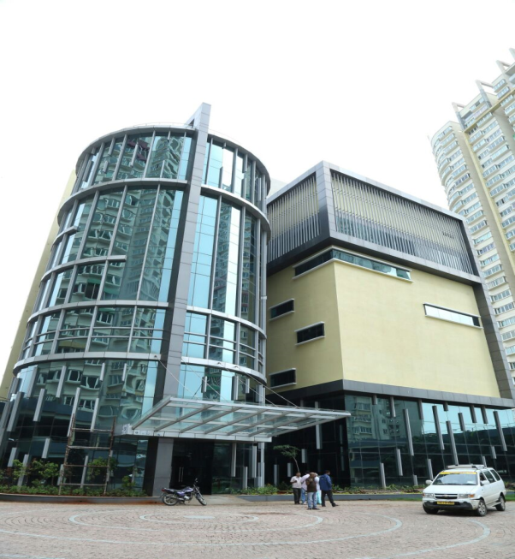
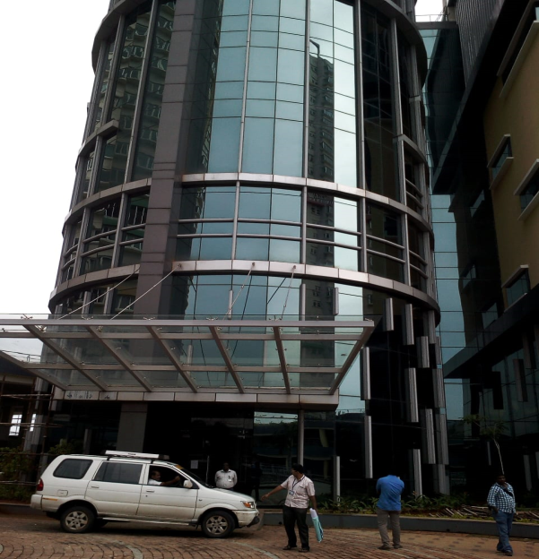
COMMERCIAL BUILDING
Com - 001
Location of Property | OMR , KAZHIPATTUR
Total area of land | 58858 sq.ft
Constructed area | 67460 sq.ft (GF+FF+2ND F+3RD F+4TH F+5TH F+6TH F)
Year of construction | Under Construction
Current market value | Rs. 3973.00 lacs

Slide 2
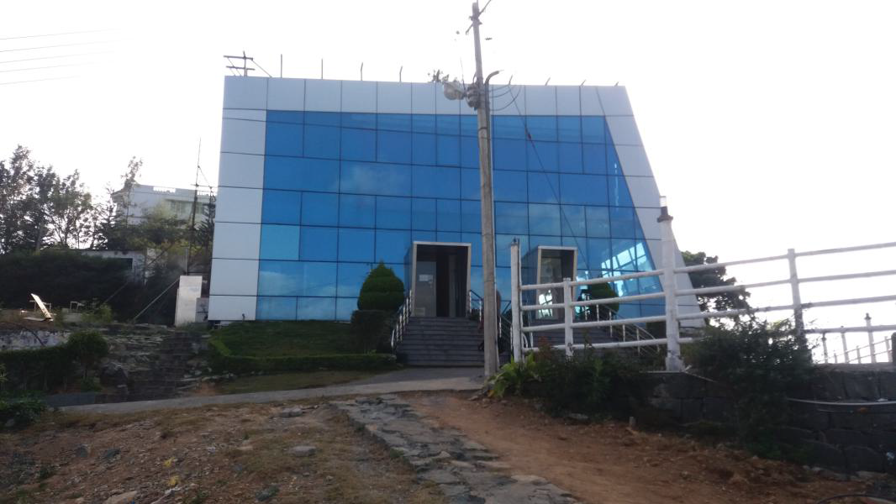
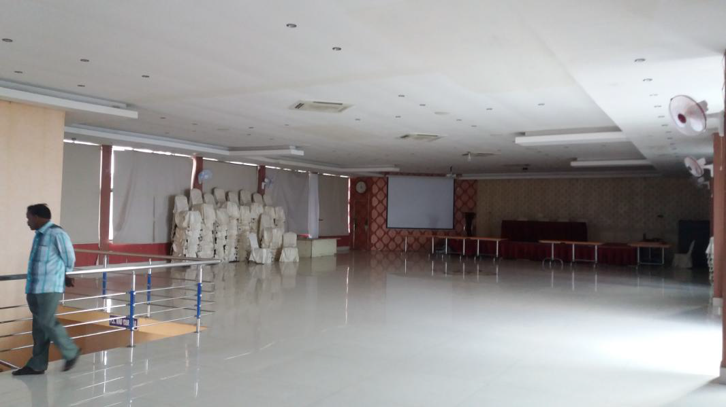
COMMERCIAL BUILDING
com - 002
Location of Property | YERCAUD
Total area of flat | 6650 sq.ft
Constructed area | Ground Floor &First floor – 9240 sq.ft
Year of construction | 2012
Current market value | Rs. 205.00 lacs

Slide 3
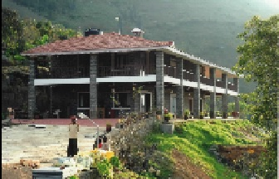
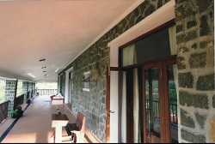
COMMERCIAL BUILDING
com - 003
Location of Property | KODAIKANAL,DINDUGAL
Total area of land | 2.06 Acre
Constructed area | Ground floor & First floor- 5346 sq.ft
Year of construction | 2012
Current market value | Rs. 193.00 lacs

Slide 4
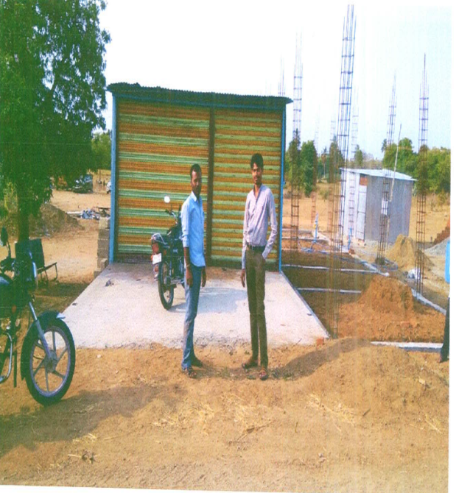
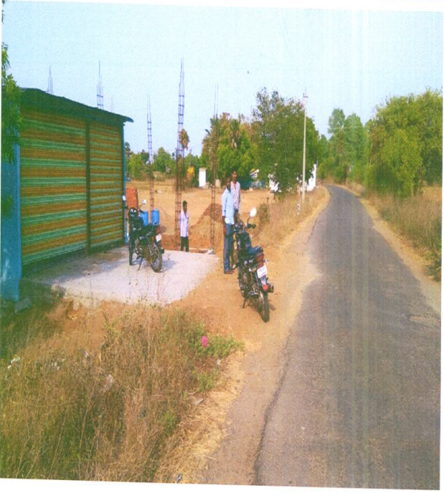
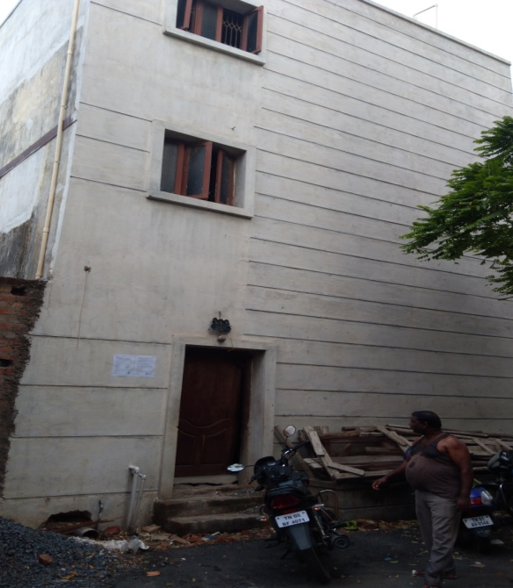
COMMERCIAL BUILDING
com - 004
Location of Property | TIRUVANNAMALAI/NAIDUMANGALAM
Total area of land | 1225 Sq.ft
Constructed area | Go down constructed afterwards
Year of construction | 2004
Current market value | Rs. 7.74 Lacs

Slide 5
COMMERCIAL BUILDING
com - 005
Location of Property | AVADI ,CHENNAI
Total area of land | 1538 sq.ft
Constructed area | 2432 sq.ft (GF+FF)
Year of construction | 2014 &2015 resp.
Current market value | Rs. 65.62 Lacs

Slide 6
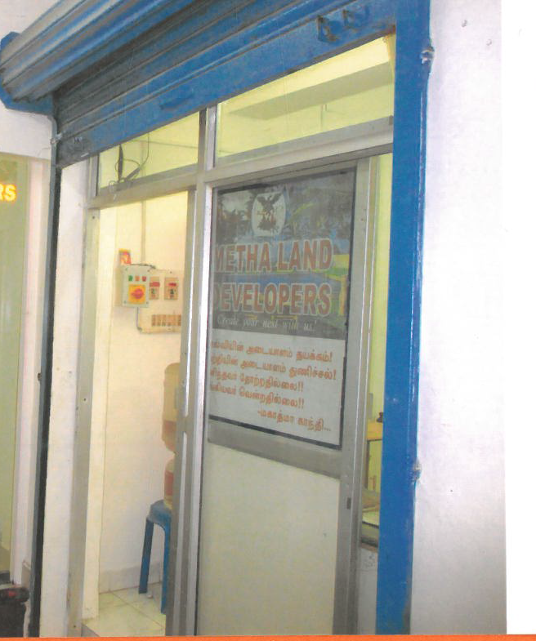
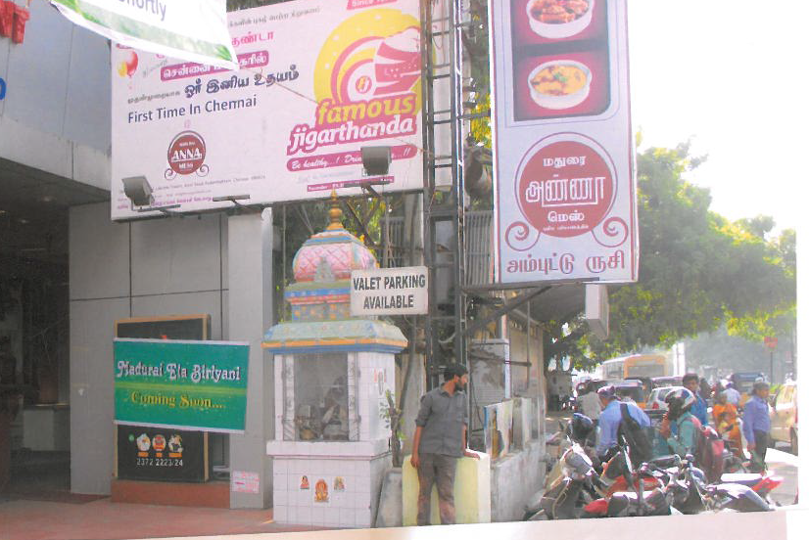
COMMERCIAL BUILDING
com - 006
Location of Property | Lakshmi Towers Arcot Road Kodambakkam
Total area of land
Constructed area | Shop no 8 349 sq ft with UDS of 86 sq ft Shop no 9 269 sq ft with UDS of 66.3 sq ft
Year of construction
Current market value | 22.88 lakhs
Sale value | 20.59 lakhs

Slide 7
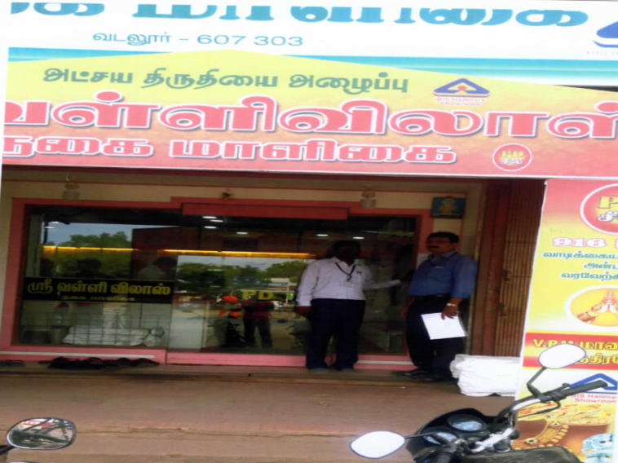
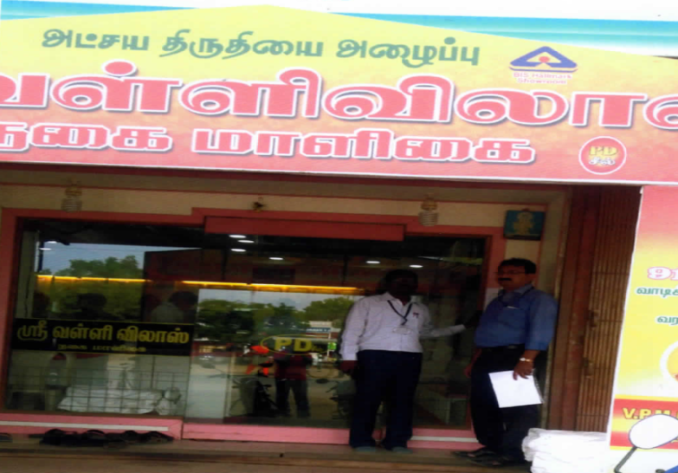
COMMERCIAL BUILDING
com - 007
Location of Property | VADALUR
Total area of land | 436.00 sq.ft
Constructed area | 418 sq.ft
Year of construction | 1971
Current market value | Rs.32.47 Lacs

Slide 8
COMMERCIAL BUILDING
com - 008
Location of Property | KATPADI,VELLORE
Total area of land | 44003 sq.ft
Constructed area | Industrial Area
Year of construction
Current market value | Rs. 40.00 lacs

Slide 9
COMMERCIAL BUILDING RESIDENTIAL BUILDING
com - 009
Location of Property | TIRUPPUR
Total area of land | 13952 sq.ft
Constructed area | 4465 sq.ft (Building,Godown.Labour Quarter)
Year of construction | 2014
Current market value | Rs.69.60 lacs

Slide 10
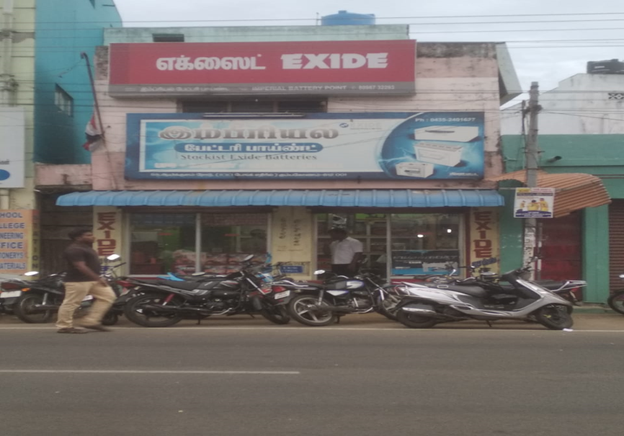
COMMERCIAL BUILDING
com - 010
Location of Property | KUMBAKONAM
Total area of land | 368 sq.ft
Constructed area | Ground Floor+First Floor (368 sq.ft)
Year of construction | 2002
Current market value | Rs. 31.90 Lacs

Slide 11
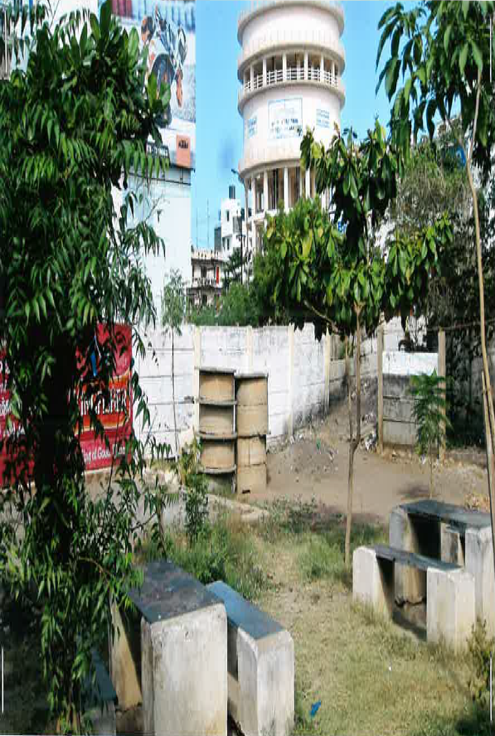
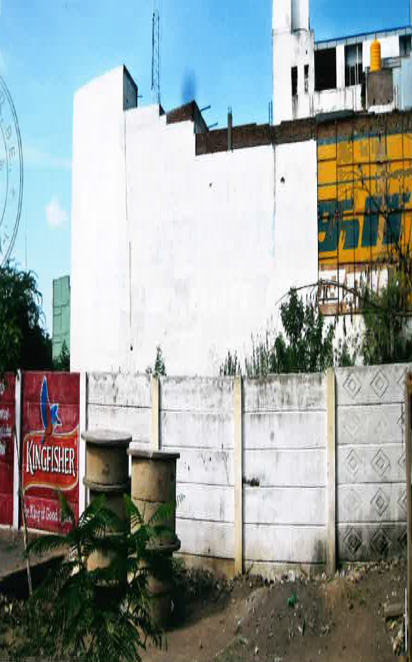
COMMERCIAL BUILDING
COM - 011
Location of Property | PUDUCHERRY
Total area of land | 1410 sq.ft
Constructed area | Commercial Area
Year of construction | ---
Current market value | Rs. 39.50 Lacs

Slide 12
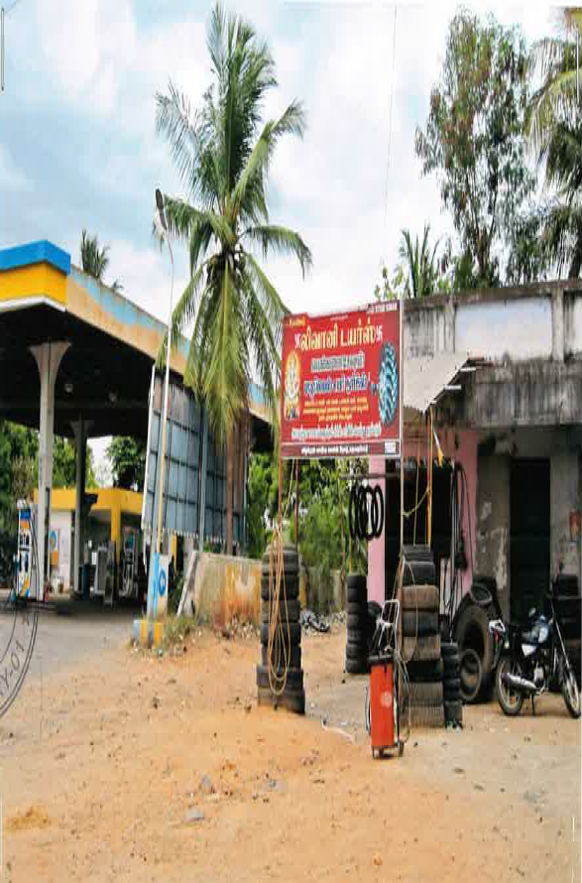
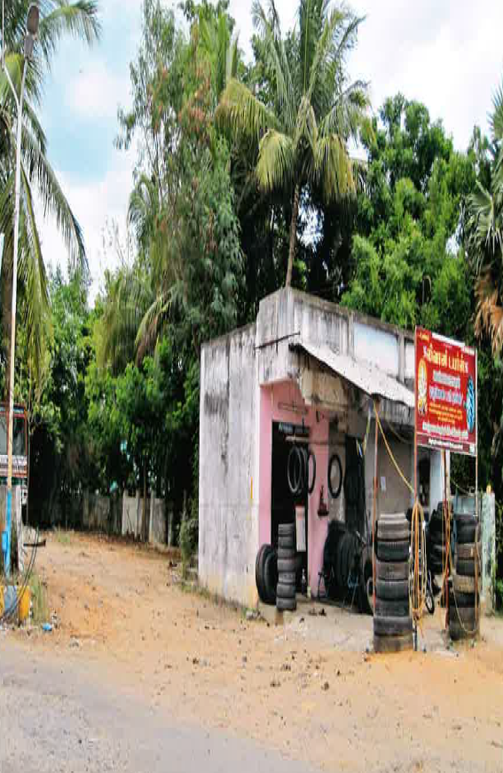
COMMERCIAL BUILDING
COM - 012
Location of Property | MADHAGADIPET,PUDUCHERRY
Total area of land | 4824 sq.ft
Constructed area | 220 sq.ft
Year of construction | 2008
Current market value | Rs. 40.80 Lacs

Slide 13
COMMERCIAL BUILDING v
COM-013
Location of Property | SALEM
Total area of land | 2272 sq.fts
Constructed area | NA
Year of construction | NA
Current market value | Rs. 68.07 lacs

Slide 14
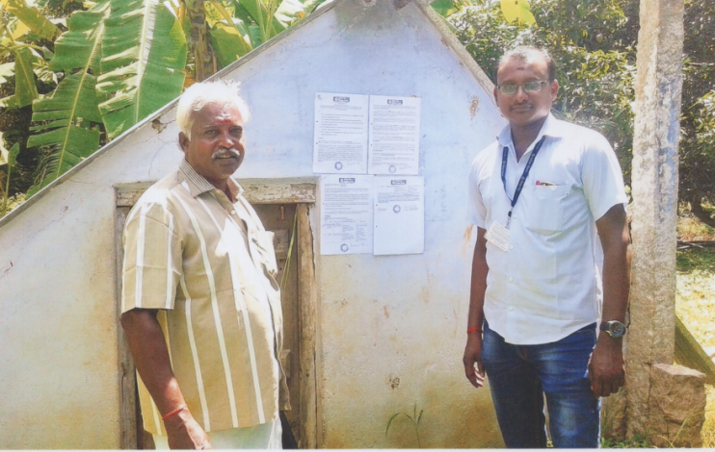
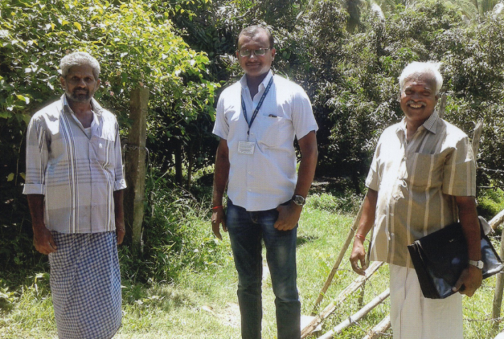
MANGO ORCHARD – AGRI LAND
COM-014
Borrower Name | SYED ABDAGIR
Location of Property | BODINAYAKANUR, Theni Dist.
Total area of land | 5.64 Ac + 5.30 Ac = 10.94 Acres
Constructed area | 80 Sq.ft (Motor Room)
Current market value | Rs.45.12 L (5.64 Ac) + Rs.42.40 L (5.30 Ac)

Slide 15
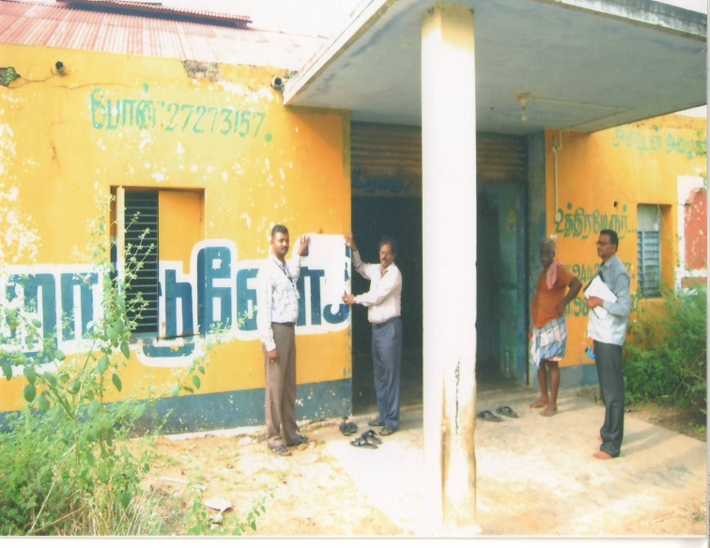
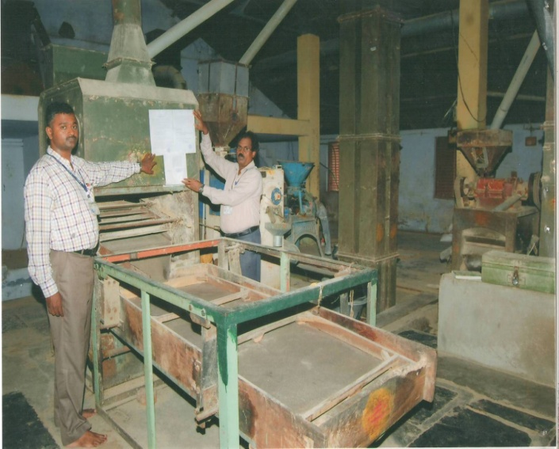
COMMERCIAL BUILDING
COM-015
Location of Property | M/s Sri. Gopalakrishna Modern Rice and Ground Nut Mill , Aandithangal Village, Uthiramerur taluk
Total area of land | 20,430 sq.ft
Constructed area | 4,121 sq.ft
Year of construction | 1991
Current market value | Rs. 57 Lakh

Slide 16
COMMERCIAL LAND
COM - 016
Location of Property | (PRISCO)COIMBATORE TOWN
Total area of land | 65.30 Cents
Constructed area | NA
Year of construction | NA
Current market value | Rs. 30.69 Crore

Slide 17
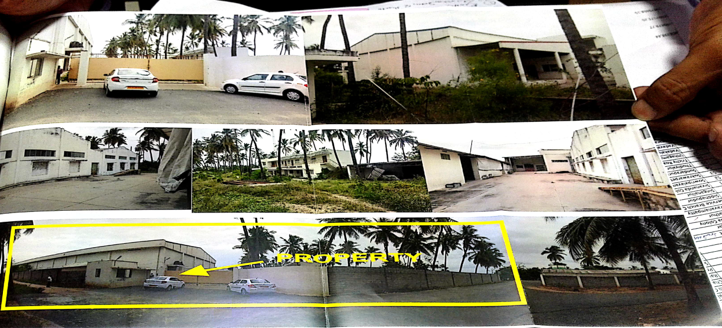
COMMERCIAL LAND & BUILDING
COM - 017
Location of Property | M/S DURAIRAJ MILL P LTD UNIT- I COIMBATORE
Total area of land | 4.44 Acres
Constructed area | NA
Year of construction | NA
Current market value | Rs. 480.00 Lacs

Slide 18
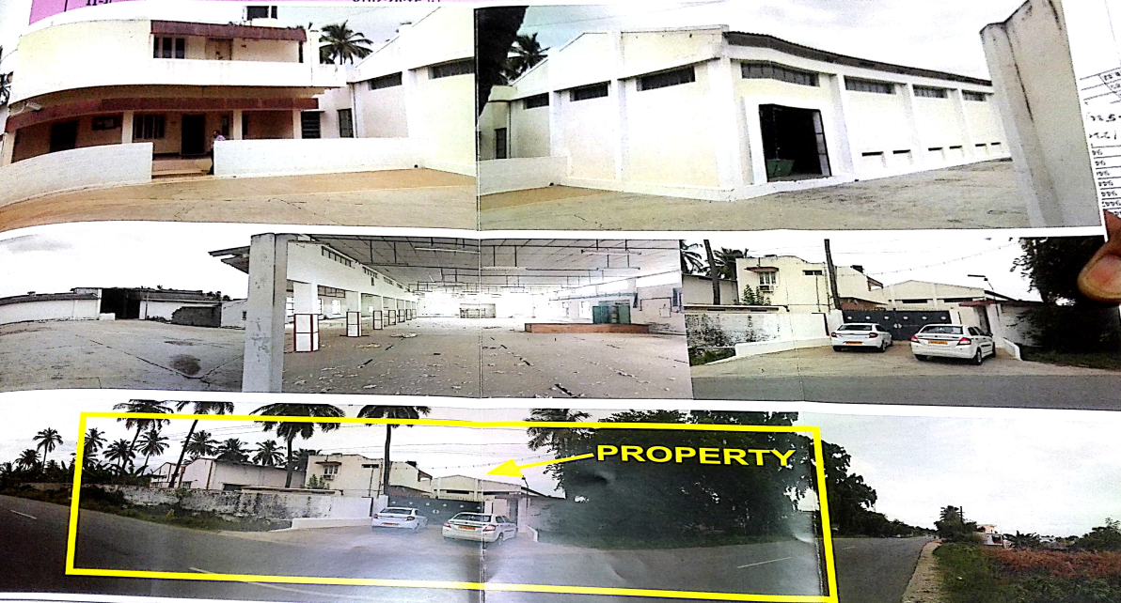
COMMERCIAL LAND & BUILDING
COM - 018
Location of Property | M/S DURAIRAJ MILL P LTD UNIT- I COIMBATORE
Total area of land | 1.385 Acres
Constructed area | NA
Year of construction | NA
Current market value | Rs. 210.00 Lacs

Slide 19
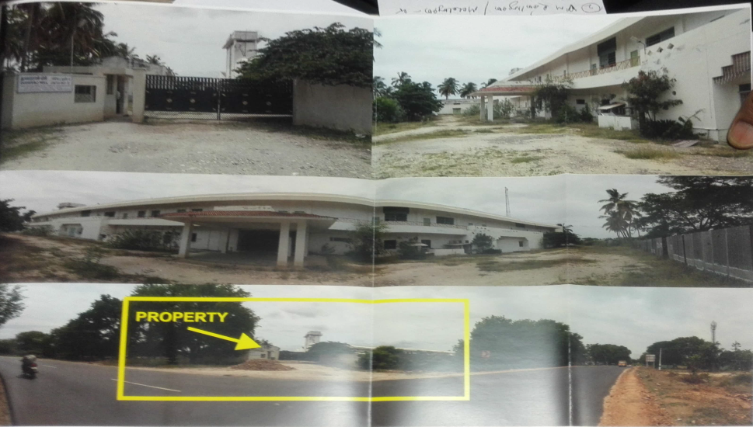
COMMERCIAL LAND & BUILDING
COM -019
Location of Property | M/S DURAIRAJ MILLS P LTD UNIT-II COIMBATORE
Total area of land | 10.02 Acres
Constructed area | NA
Year of construction | NA
Current market value | Rs. 1470.00 Lacs

Slide 20
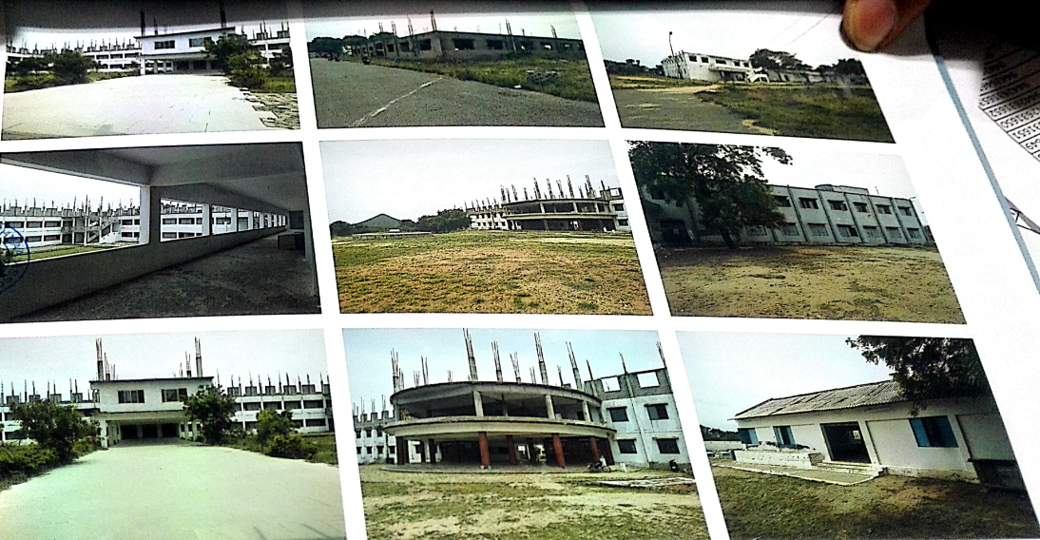
COMMERCIAL LAND &BUILDING
COM -020
Location of Property | NARAYANSAMY EDU TRUST,TIRUPPUR
Total area of land | 32.42 Acre
Constructed area | NA
Year of construction | NA
Current market value | Rs. 3410.00 lacs

Slide 21
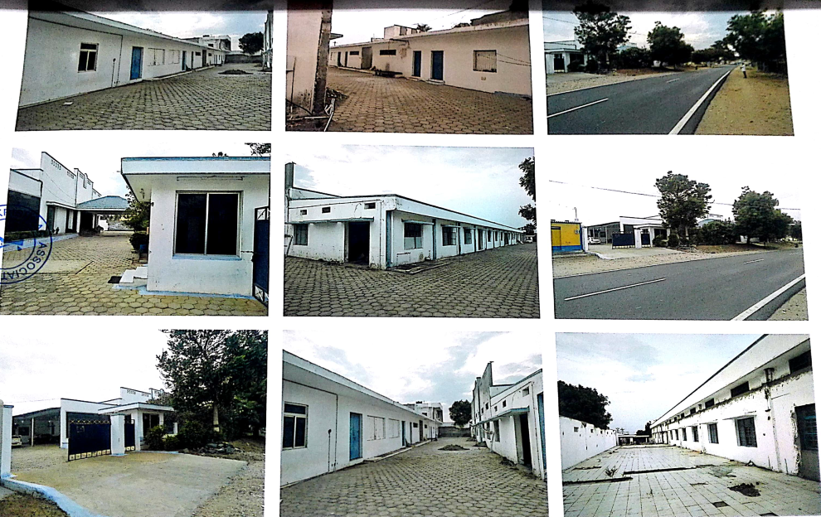
COMMERCIAL LAND & BUILDING
COM -021
Location of Property | (VISWA FASHION) TRIPUR
Total area of land | 1.23 Acres
Constructed area | Plinth area 35365 sq.ft
Year of construction | --
Current market value | Rs. 357.00 Lacs

Slide 22
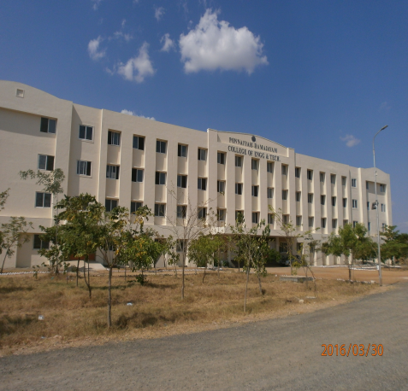
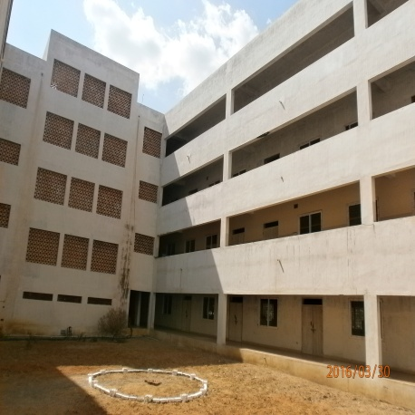
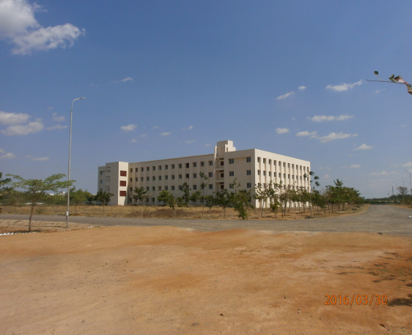
COMMERCIAL LAND & BUILDING
COM- 022
Location of Property | PRIST ,MADURAI
Total area of land | 24.71 Acres
Constructed area | --
Year of construction | --
Current market value | Rs.51.73 Crore

Slide 23
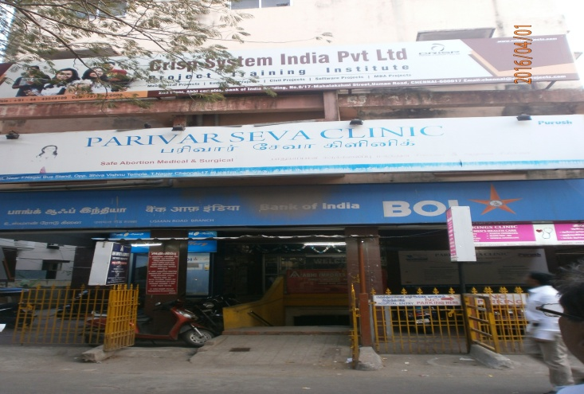
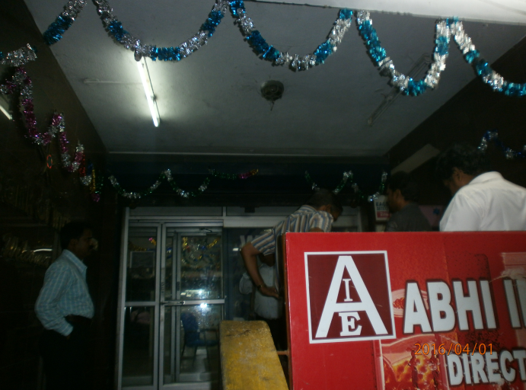
COMMERCIAL LAND & BUILDING
COM-023
Location of Property | T NAGAR,CHENNAI
Total area of land | 7270 sq.ft
Constructed area | 625 sq.ft
Year of construction | --
Current market value | Rs.6.29 Crore

Slide 24
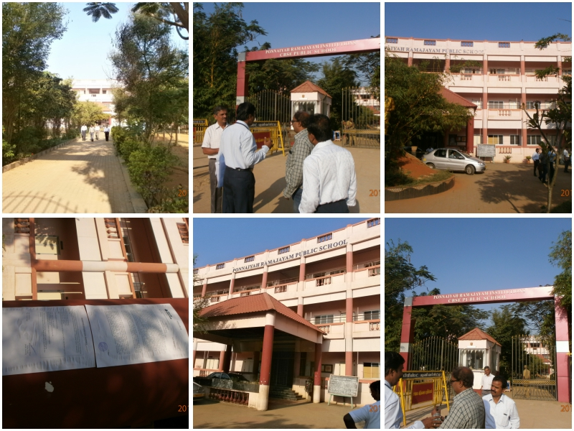
COMMERCIAL LAND & BUILDING
COM-024
Location of Property | PRIST ,KUMBAKONAM
Total area of land | 5.065 Acre
Constructed area | --
Year of construction | --
Current market value | Rs.22.50 Crore

Slide 25
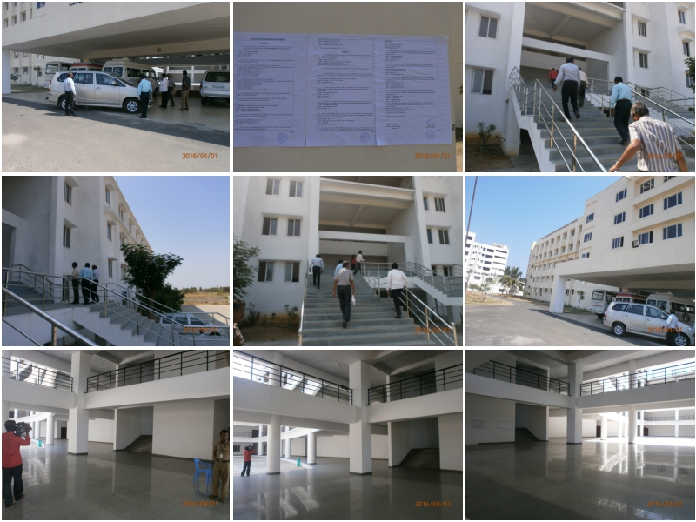
COMMERCIAL LAND & BUILDING
COM-025
Location of Property | PRIST MANMAINALLUR,KAANCHIPURAM
Total area of land | 10.06 +27.81 Acres
Constructed area | --
Year of construction | --
Current market value | Rs.188.89 Crore

Slide 26
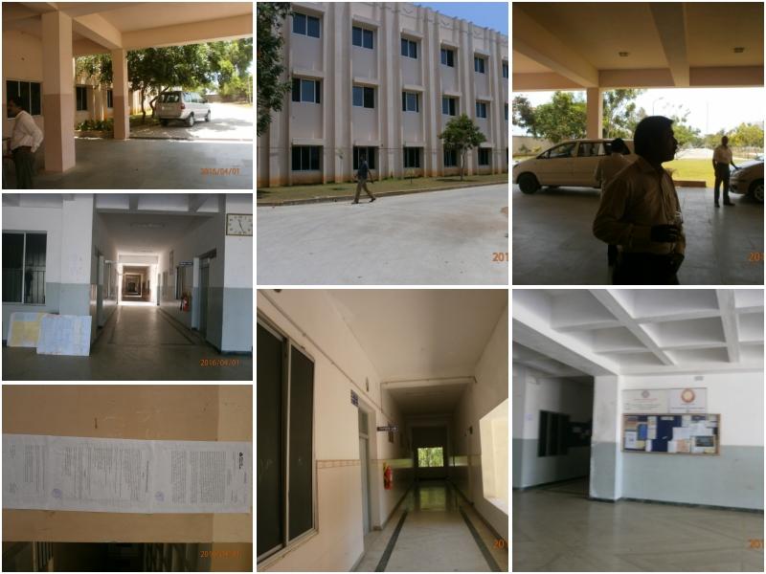
COMMERCIAL LAND & BUILDING
COM-026
Location of Property | PUDUCHERRY
Total area of land | 8.638 acres + 1:06:60 hectares
Constructed area | --
Year of construction | --
Current market value | Rs.22.58 Crore

Slide 27
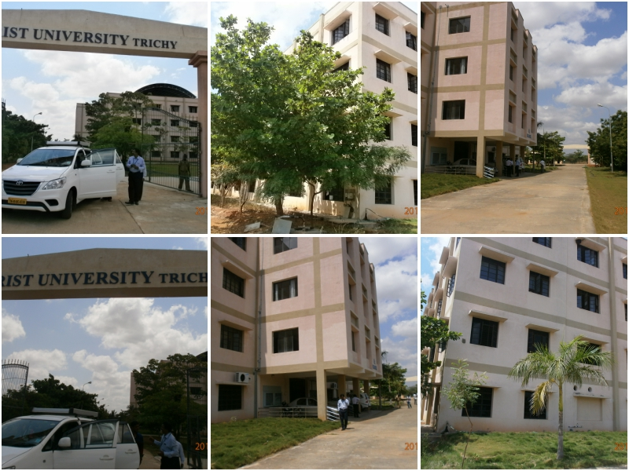
COMMERCIAL LAND & BUILDING
COM-027
Location of Property | PRIST,TRICHY
Total area of land | 3 acres 48 cents
Constructed area | --
Year of construction | --
Current market value | Rs.20.27 Crore

Slide 28
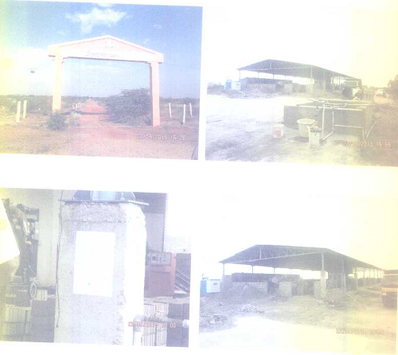
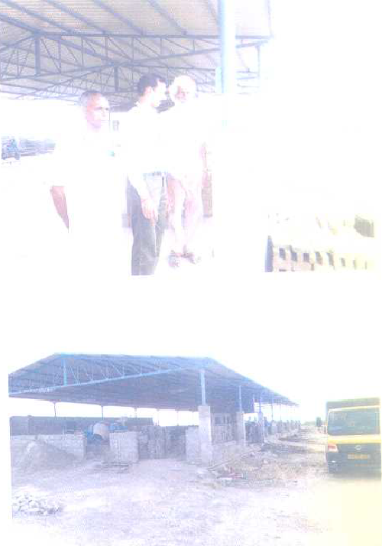
Commercial Plot
COM - 028
Location of Property | Baba Flybricks ARMB-Virudhunagar – Arupukkotai-Periyanayagipuram
Total area of land | 100 cents
Constructed area | 6487 sq ft
Year of construction | 2013
Current market value | Rs 67 lakhs
Sale value | Rs 56.95 lakhs

Slide 29
COMMERCIAL LAND & BUILDING
com - 029
Location of Property | HOSUR,KRISHNAGIRI
Total area of land | 3.82 Acre
Constructed area | 47617 sq.ft
Year of construction | 2010
Current market value | Rs.285.59 lacs

